Slide 1
Gene Screening for Worms’ Neuronal Identification
Intuition: iterating over all possible gene combinations
195 Neurons
Genes
+
NeuroPAL spatial info.
NeruoPAL | Promoter | RNA Seq* | FISH
Partitioning a set of neurons into multiple local topological neighbors
stable
diverse
gene set
iterative combination & union
*: Seth R. Taylor, et al., Molecular topography of an entire nervous system. (2021). Cell 184, 4329–4347.

Slide 2
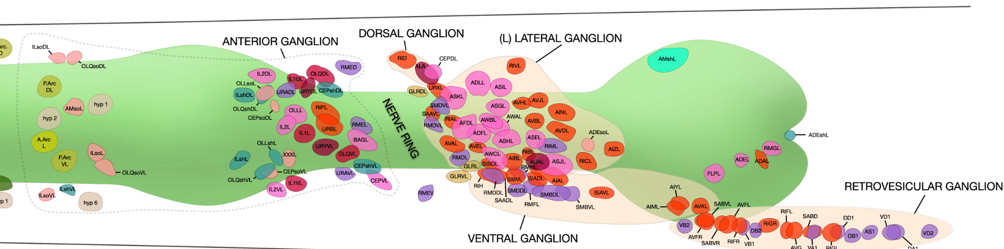
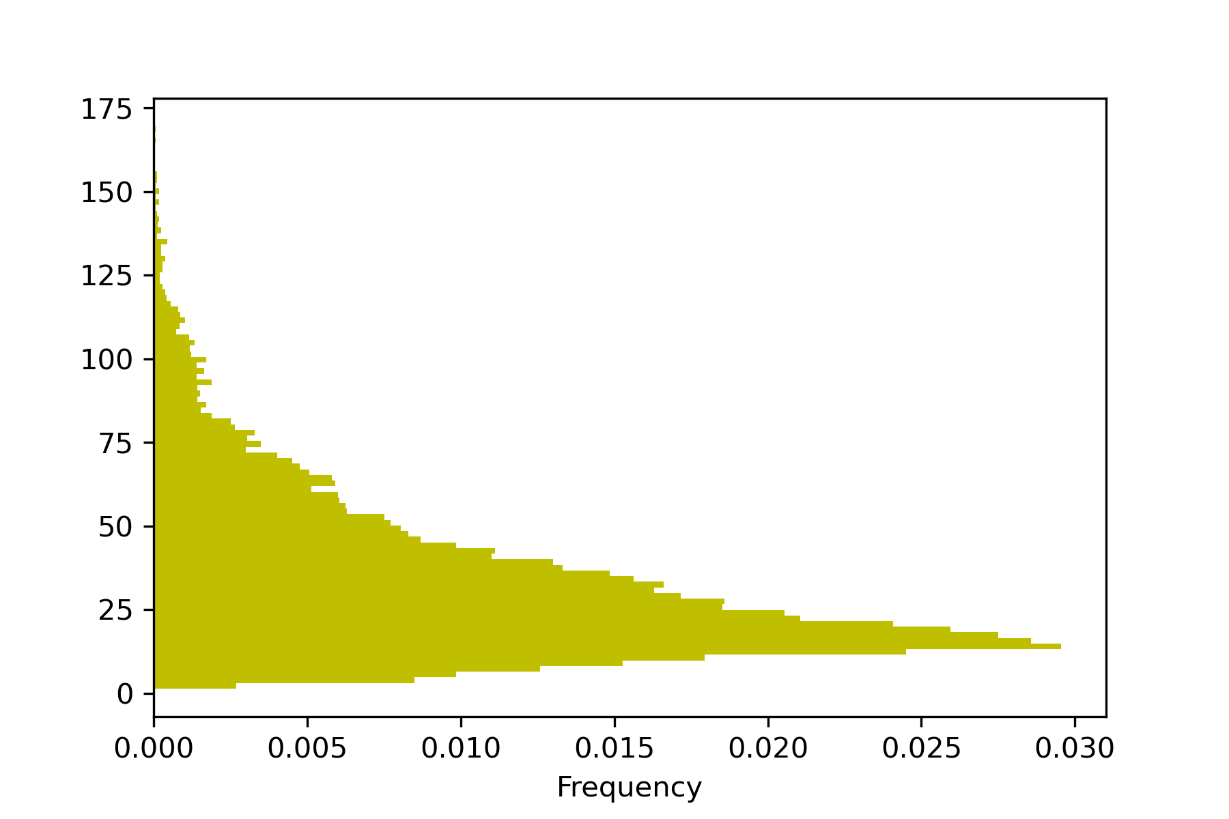
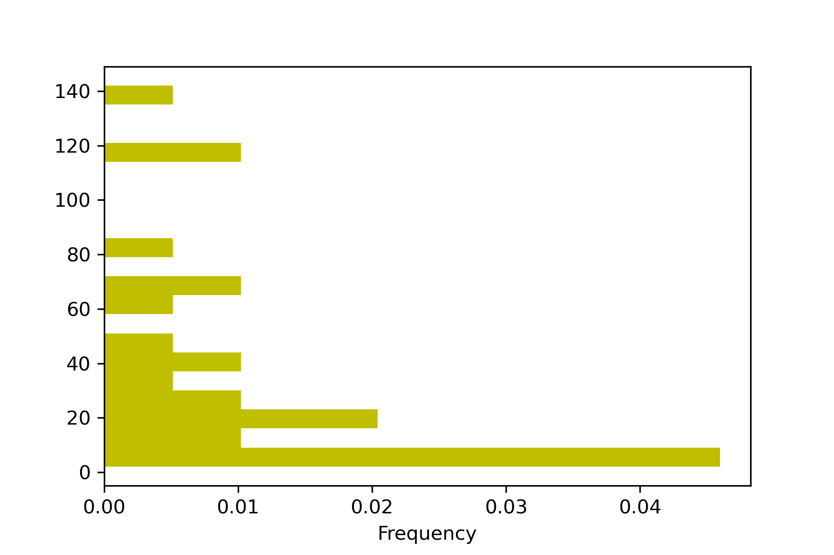
Spatial Topological Relations of Neurons
8.34
sita
sigma
Nmin
Nmin: topological distance between neurons
sigma: neurons with equal status
sita: spatial angel between two neighbor neurons with the central neuron
between any two neurons
between two ganglia

Slide 3
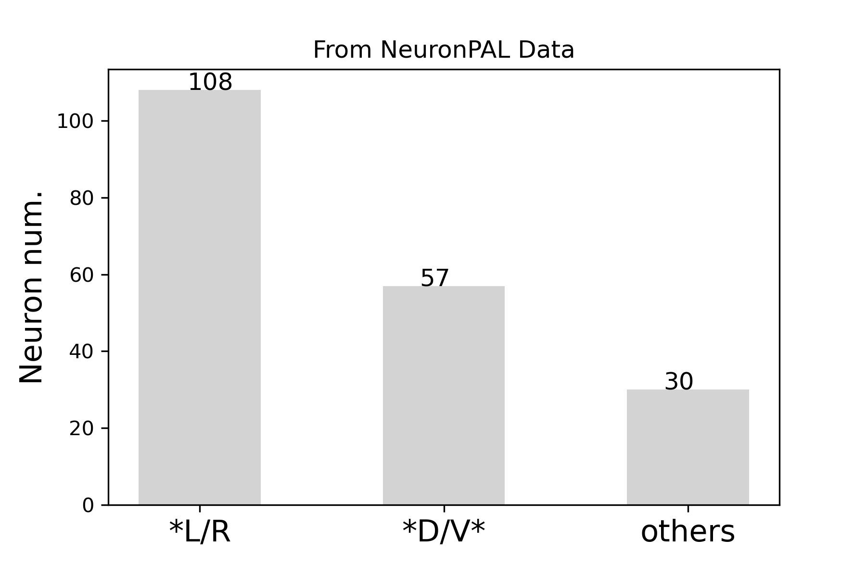
Neuron Types
From NeuroPAL
From promoter
Neurons Type | represent neurons |  | *R/L neurons |  | *D/V* neurons
 | Neuron num. | average number of diff. genes | different neuron paris | average number of diff. genes | Neuron num. | average number of diff. genes
Diff. Num. | 85 | 57/796 | 1/54 | 6/796 | 18 | 4/796
From scRNA seq*
No distinguish: * R vs * L
No distinguish: * D vs * V
*: Seth R. Taylor, et al., Molecular topography of an entire nervous system. (2021). Cell 184, 4329–4347.

Slide 4
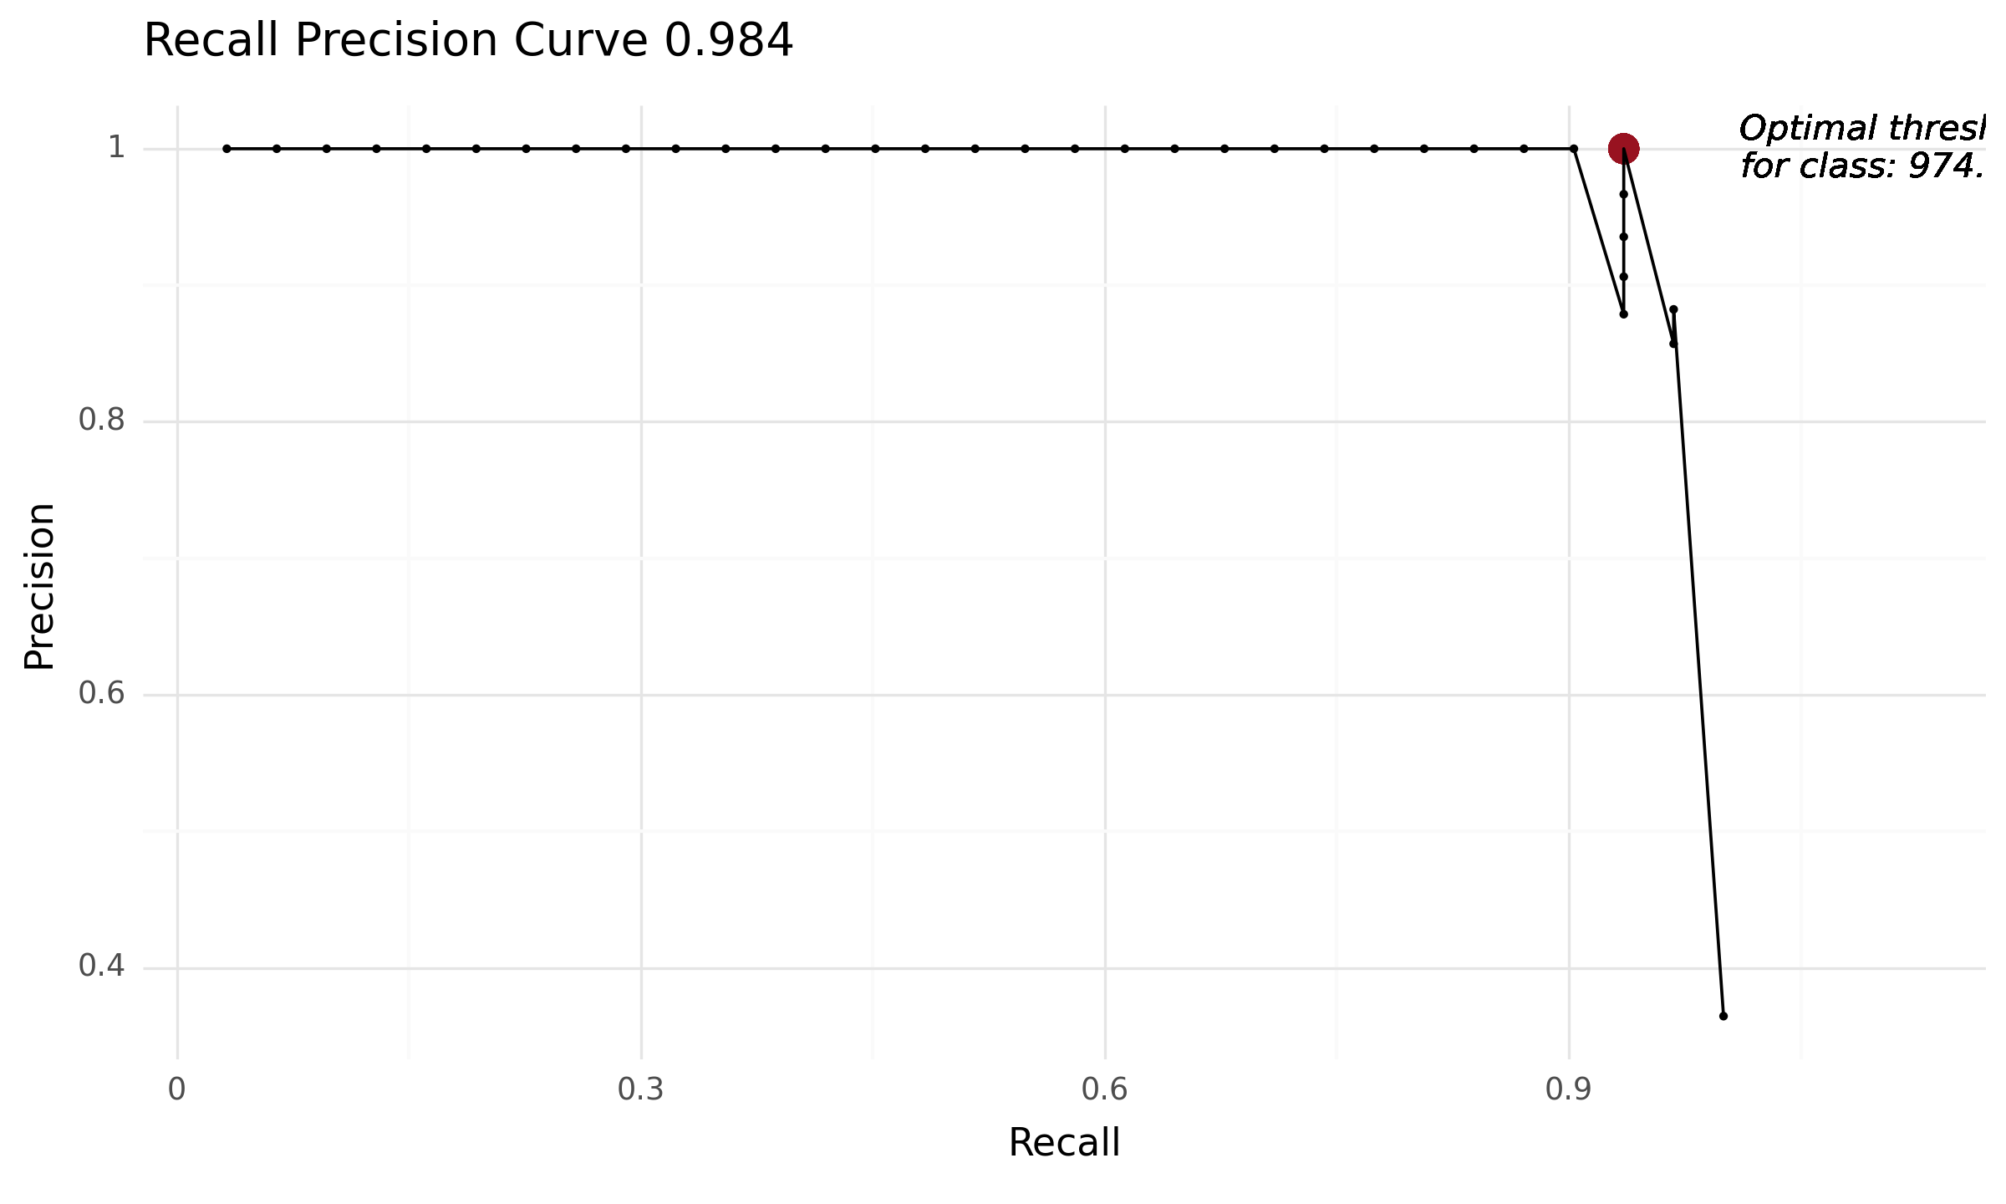
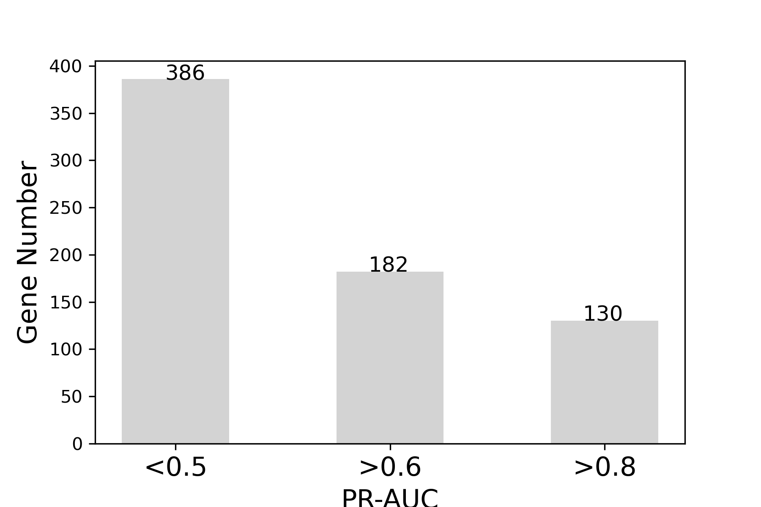
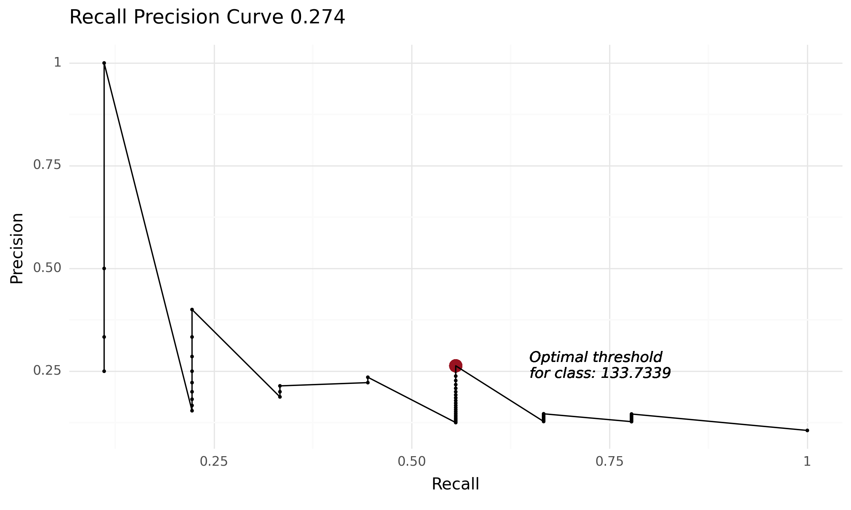
Gene Combination
 | promoter | scRNA seq* | Bulk RNA seq* | FISH
Neurons | 179 (withL/R/D/V) | 128 | 39 | --
Genes | 796 | 13669 | 22289 | --
Threshold selection of gene expression for seq data
by F1 score
*: Seth R. Taylor, et al., Molecular topography of an entire nervous system. (2021). Cell 184, 4329–4347.

Slide 5
Result
Taken data position_7 from NeuroPAL as an example
T.B. Parameters:
Nmax = 8.34
sigma = 0.5
sita = 5
80 neuron sets /92
Maximum combinations = 9
Running ...
+
Gene selection Parameters:
PR-AUC >= 0.8
130 genes
Currently,
to increase differently expressed genes
to combine spatial transcriptome data for detailed analysis

